Slide 1
Big Game Census Analytics

Slide 2
Introduction
The Big Game Census Dashboard provides a comprehensive analysis of player demographics and team compositions for major football teams. This dashboard is designed to help teams, analysts, and enthusiasts understand the distribution of player attributes such as age, position, and birth state, along with team-specific metrics. By leveraging this data, stakeholders can gain insights into player characteristics and team dynamics, which are crucial for strategy development, player recruitment, and performance analysis.

Slide 3
Details of Data
1. Data Overview:
Source: The dataset consists of player information from two major football teams: New England and Philadelphia.
Attributes: The data includes player age, jersey number, position, birthplace, and birth state.
Geographic Scope: Player birthplaces span across various states in the United States, with a few international locations.
2. Key Variables:
Player Age: The dataset records the age of players, with an average age of 26.72 years.
Player Weight: Includes player weight metrics, with an average weight of 243.88 lbs.
Player Position: Multiple positions are represented, including WR, QB, RB, TE, and various defensive positions.
3. Data Segmentation:
Teams: The data is segmented by the two teams, New England and Philadelphia.
Birth State: Analysis of players' birth states is provided, with states like California, Texas, and Florida being prominent.

Slide 4
Main KPIs
1. Average Player Age:
Measure: The average age of players across both teams.
Value: 26.72 years.
2. Player Weight Distribution:
Measure: The average weight of players, along with the minimum and maximum values.
Values:
Average Weight: 243.88 lbs.
Minimum Weight: 167 lbs.
Maximum Weight: 350 lbs.
3. Player Distribution by Birth State:
Measure: Number of players born in different states, segmented by team.
Highlight: States like California and Texas have the highest number of players.
4. Philadelphia: 49% of players.

Slide 5
Main KPIs
4. Player Composition by Position:
Measure: Number of players in each position.
Highlight: Positions like WR (Wide Receiver) and DE/RDE (Defensive End) are heavily represented.
5. Team Representation:
Measure: Number of players per team.
Values:
New England: 51% of players.
Philadelphia: 49% of players.

Slide 6
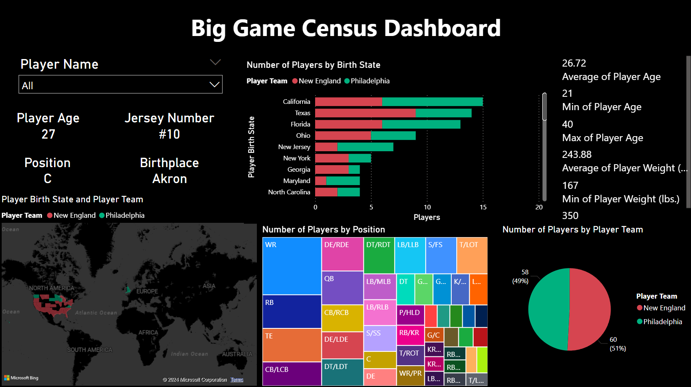
Dashboard

Slide 7
Thank you

